Slide 1
Computer Programming Adv
09-10
TEKNIK
WebSocket
Teknik Elektro

Slide 2
Definition
A WebSocket is a standard protocol for two-way data transfer between a client and server. The WebSockets protocol does not run over HTTP, instead it is a separate implementation on top of TCP.

Slide 3
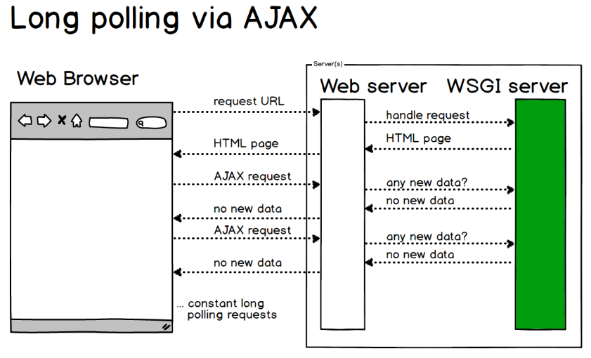
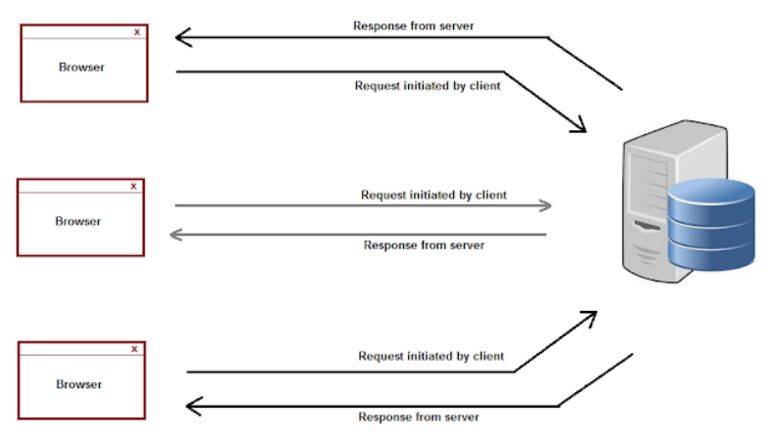
Ajax Request

Slide 4
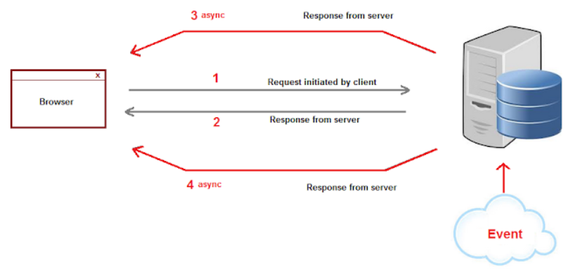
Ajax Request

Slide 5
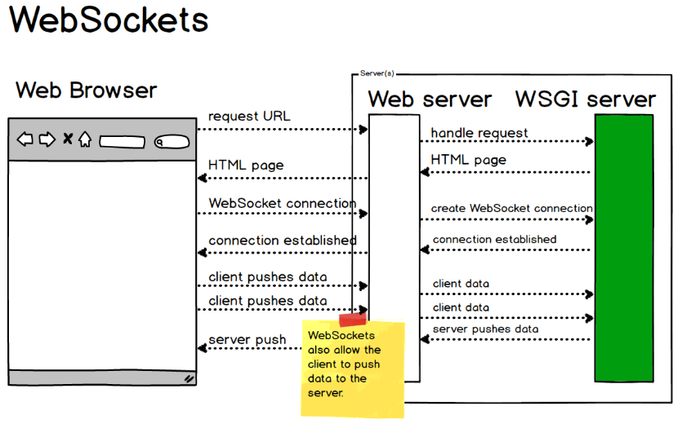
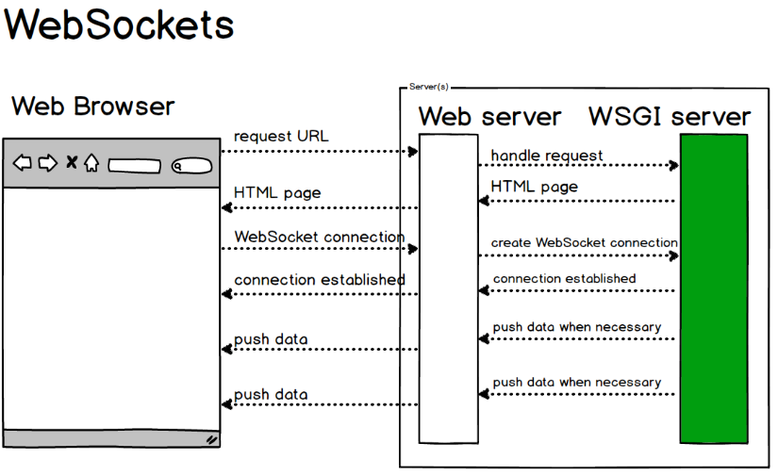
WebSockets

Slide 6
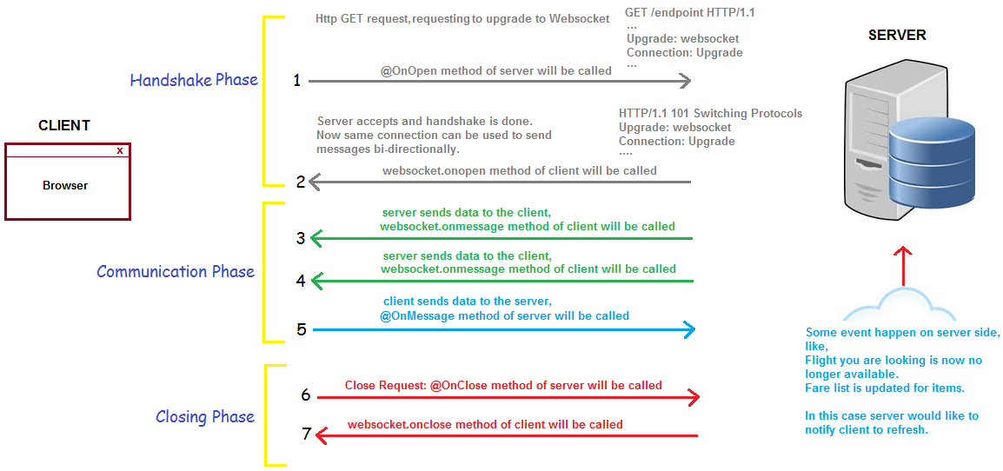
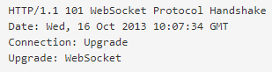
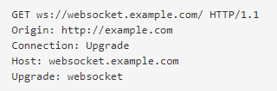
WebSocket Workflow

Slide 7
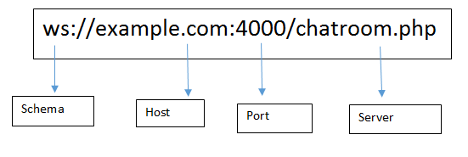
WebSocket Protocol Shema

Slide 8
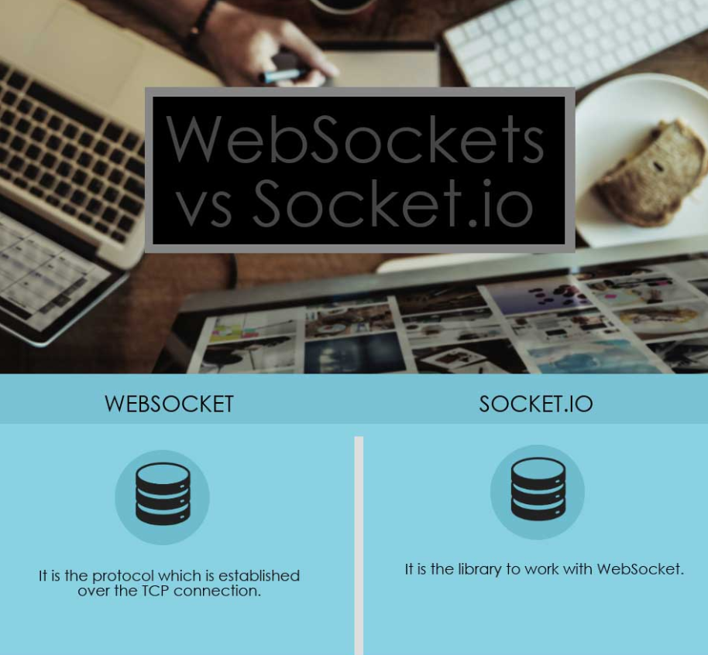
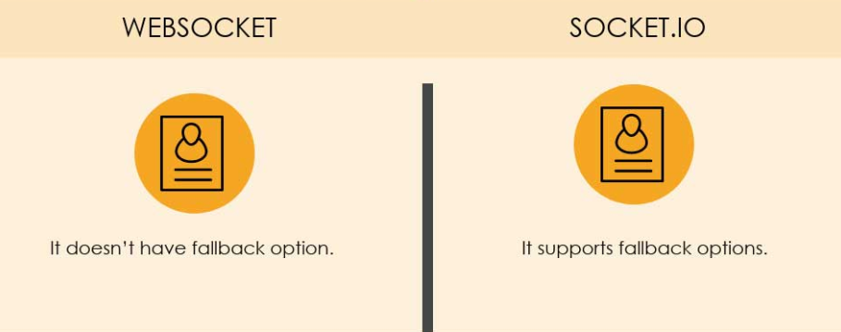
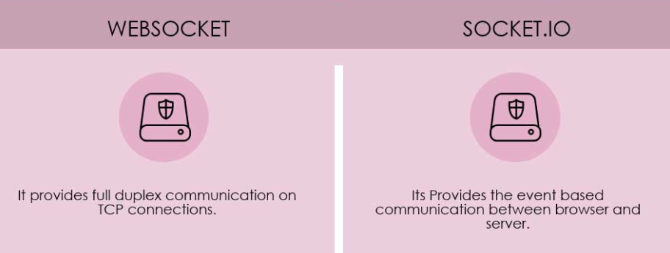
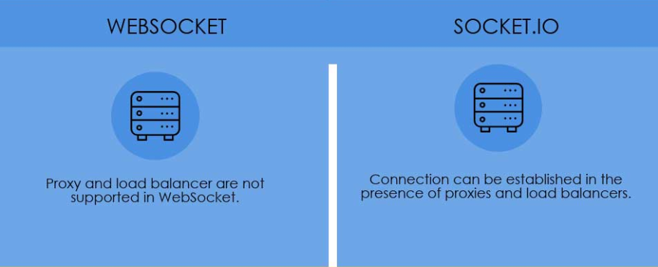
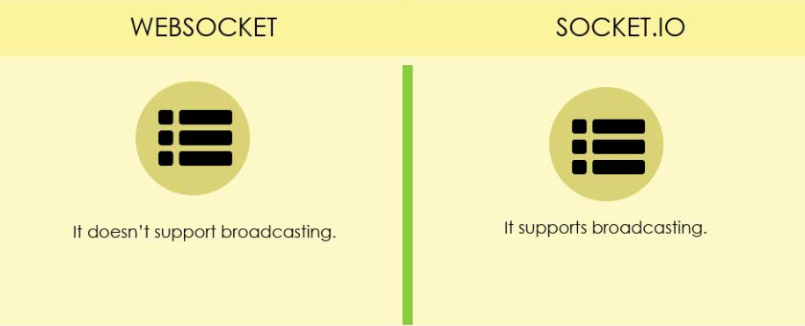
WebSocket VS Socket.io

Slide 9
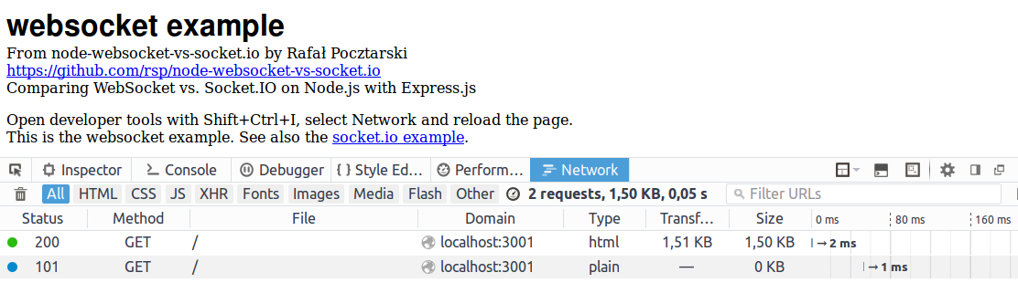
WebSocket VS Socket.io
Network traffic
WebSocket Results
2 requests, 1.50 KB, 0.05 s

Slide 10
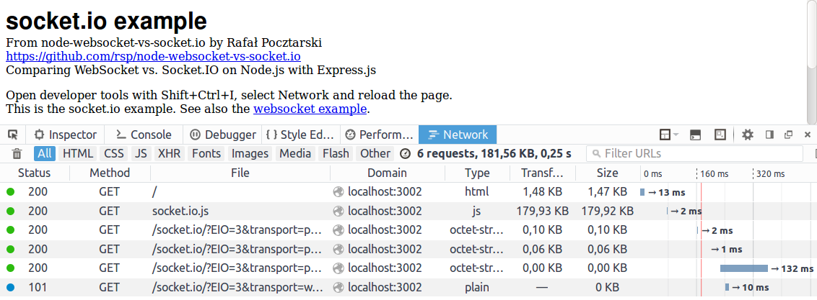
WebSocket VS Socket.io
Network traffic
Socket.IO Results
6 requests, 181.56 KB, 0.25 s

Slide 11
Our Rules
Web Socket Server
Web Socket Client
on(“connection”)
emit(“connection”)
data = ‘a client connected’
emit(“message”)
on(“message”)
on(“disconnect”)
emit(“disconnect”)
data = ‘a client disconnected’

Slide 12
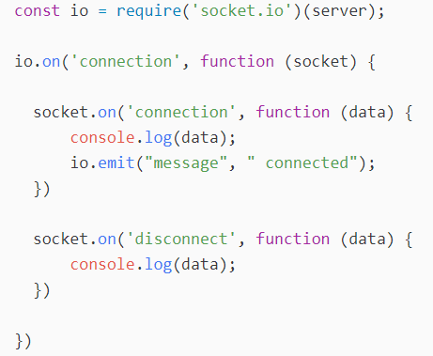
Socket Server
./bin/www

Slide 13
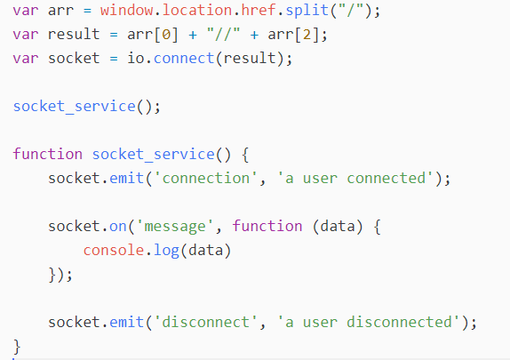
Socket Client
./public/javascripts/main/conversation.js

Slide 14
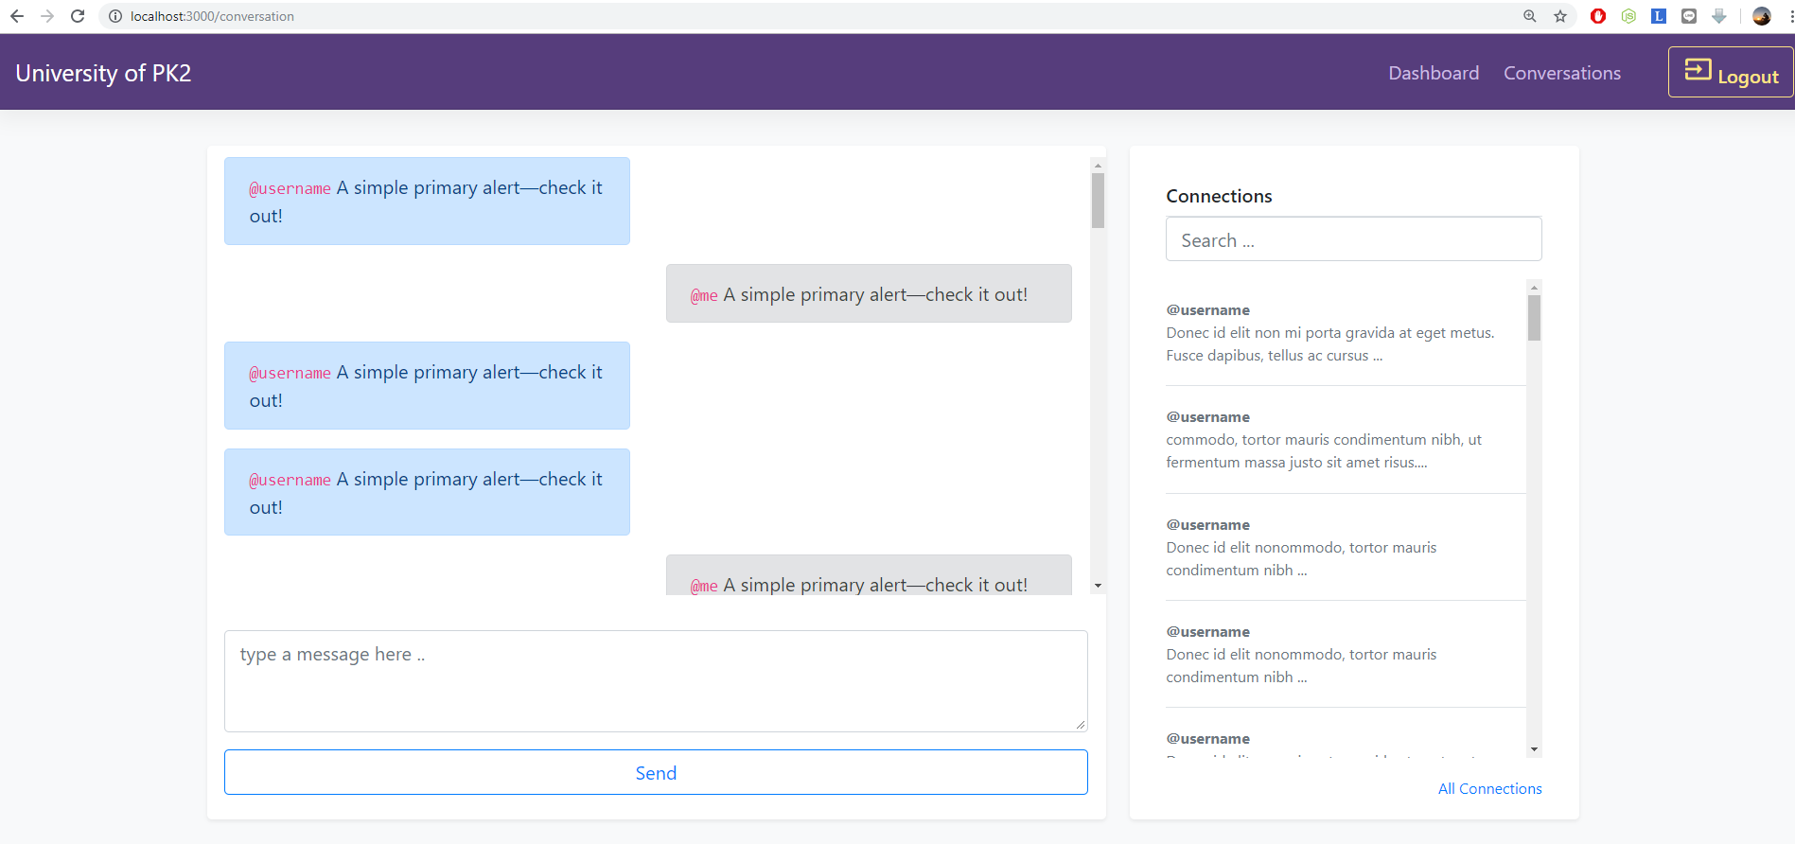
Base UI / UX
Go to your root app directory
Open your terminal or command prompt
Type “nodemon”
http://localhost:3000/conversation

Slide 15
Base UI / UX
Send Message Button
Text Area of Message
Message content
User Lists

Slide 16
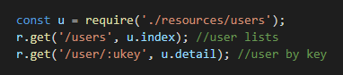
Get User List
Prepare users API
add scripts inside /api/index.js
create a new file users.js inside resources directory

Slide 17
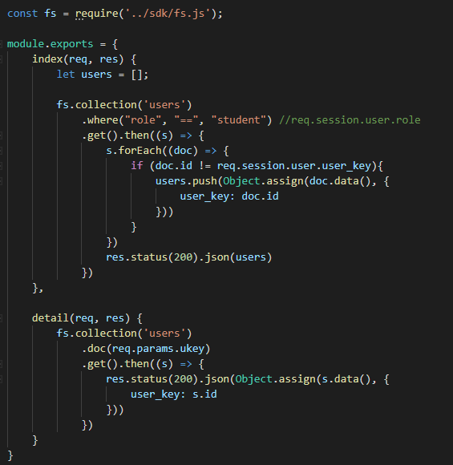
Get User List
Prepare users API
add scripts
inside ./resources/users
When get all users you should exclude your account to prevent selecting message from the same privilege or sessions

Slide 18
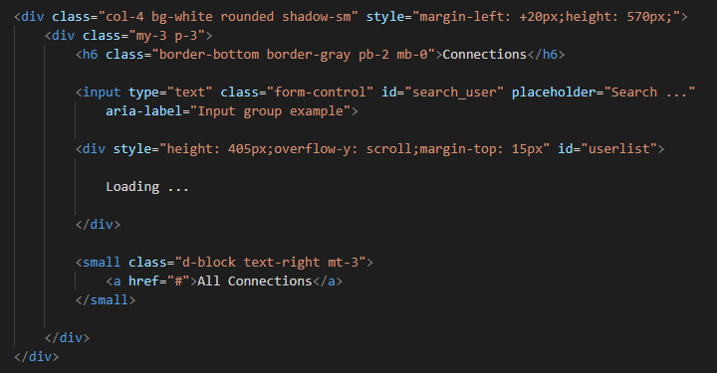
UI / UX User Lists
Edit /views/main/conversation.ejs
Remove script for… and add some id of the elements (input and div)

Slide 19
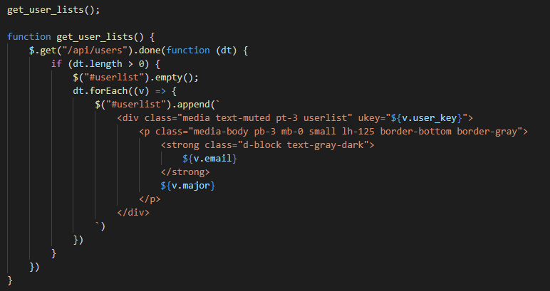
Trigger User Lists
Edit /public/javascripts/main/conversation.js
Create a new function to get user list inside the HTML5 elements

Slide 20
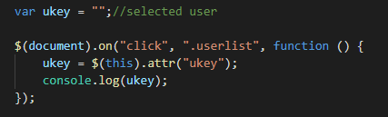
Trigger User Lists
Edit /public/javascripts/main/conversation.js
Create a handling for get user in the list by clicking a user in… we named in class userlist, so

Slide 21
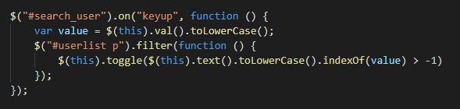
Trigger User Lists
Edit /public/javascripts/main/conversation.js
Triggering search user in the list

Slide 22
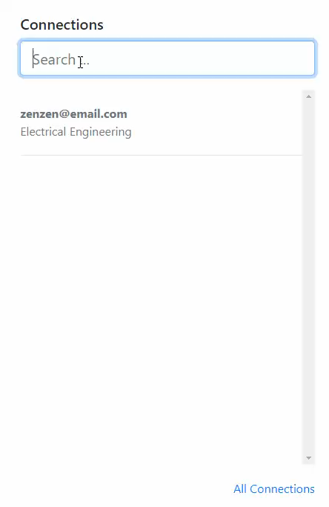
User List done

Slide 23
Our Rules
Web Socket Server
Web Socket Client
Firebase snapshots
on(“conversations”)
emit(“conversations”)
emit(“conversations”)
on(“conversations”)

Slide 24
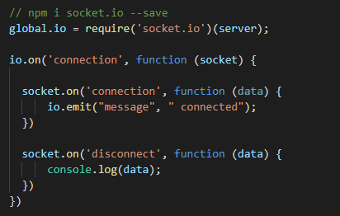
Update Socket to Global Var.

Slide 25
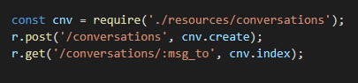
Create an API for conversations
Prepare users API
add scripts inside /api/index.js
create a new file conversations.js inside resources directory

Slide 26
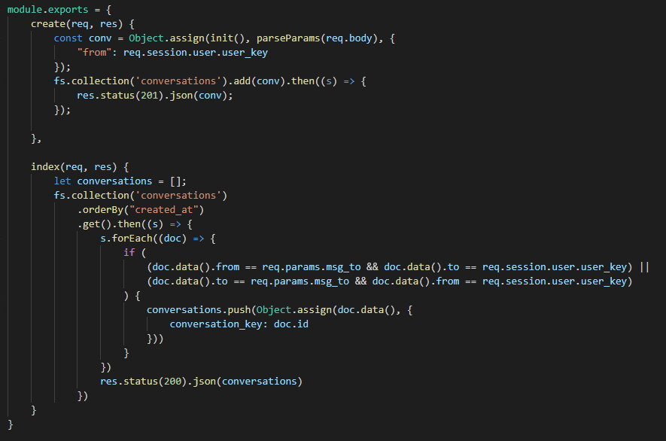
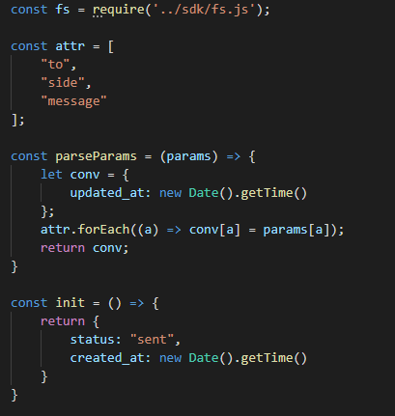
Conversations API
add scripts inside ./resources/conversations

Slide 27
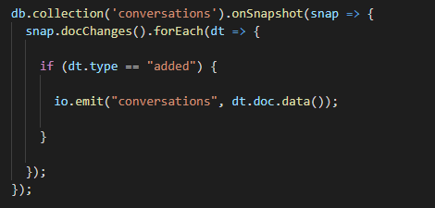
Adding snapshot in /api/sdk/fs.js
Add some scripts in api/sdk/fs/js to enable realtime between the server and firebase snapshot, then also the server and the client

Slide 28
Base UI / UX

Slide 29
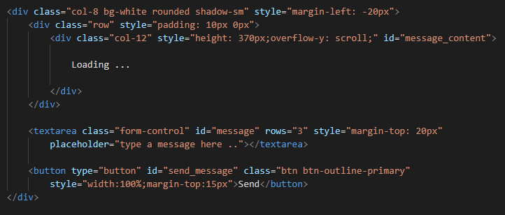
UI / UX Conversation Lists
Edit /views/main/conversation.ejs
Remove script for… and add some id of the elements (div, textarea and button)

Slide 30
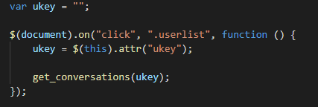
Trigger User Lists
Edit /public/javascripts/main/conversation.js
Create a handling for get user in the list by clicking a user in… we named in class userlist, so

Slide 31
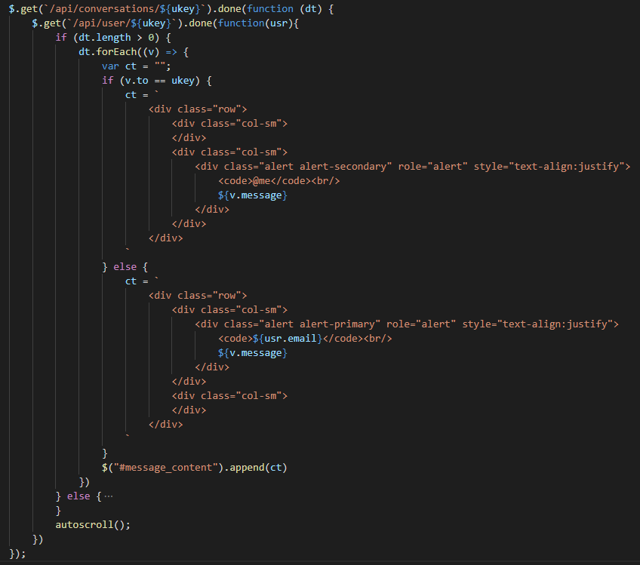
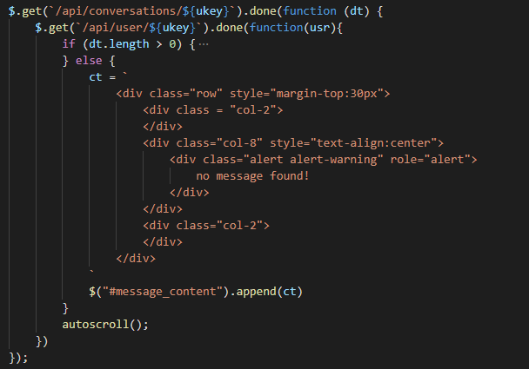
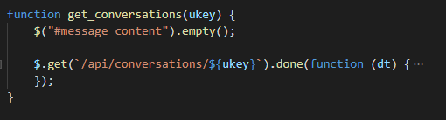
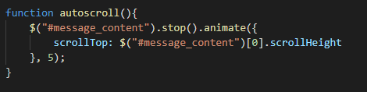
Trigger get_conversations()

Slide 32
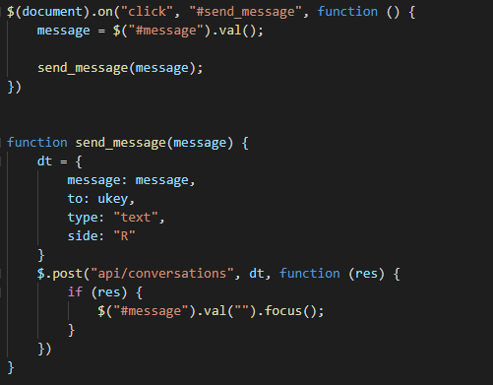
Trigger send_message()

Slide 33
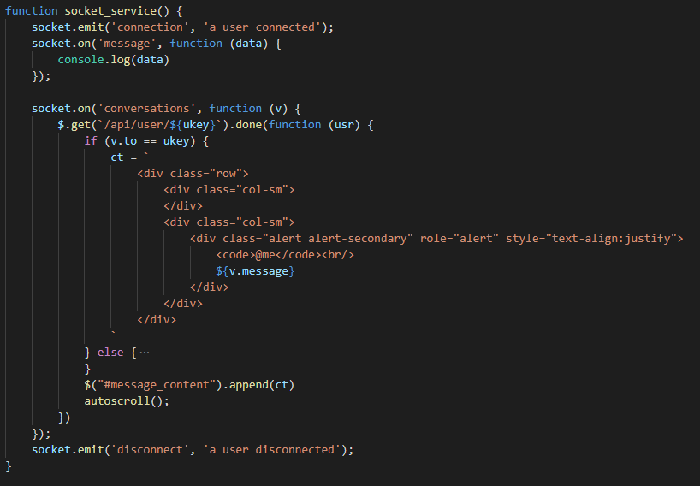
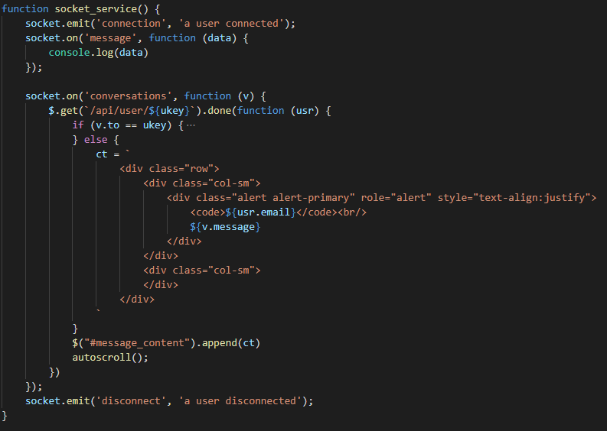
Trigger socket_service()

Slide 34
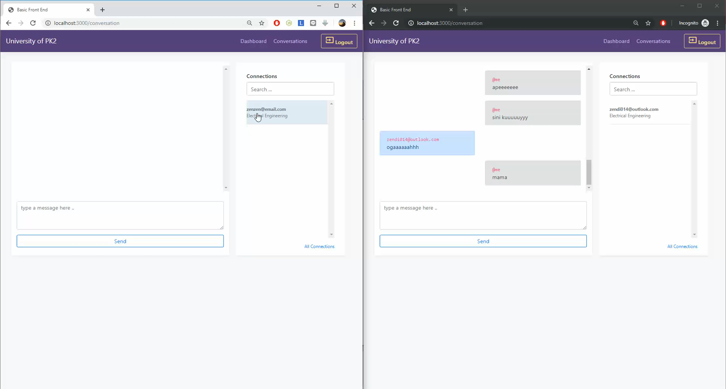

Slide 35
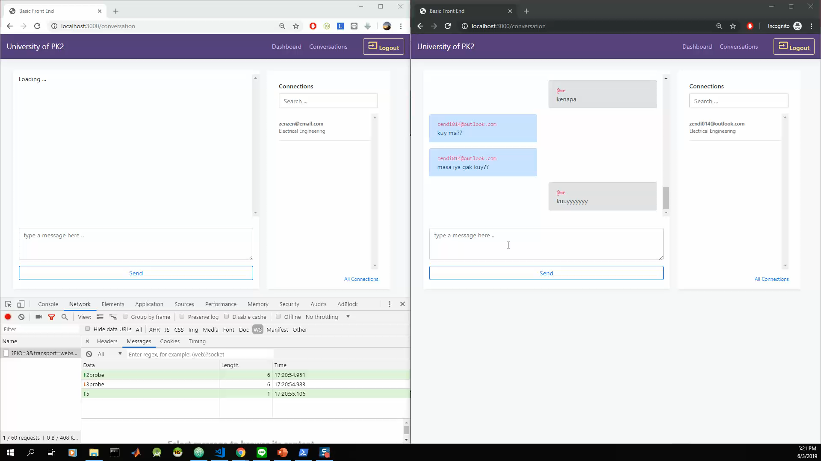

Slide 36
Zendi Iklima ST, SKom, MSc

